Slide 1
Android Application Development (I)
Practice – Project Breakdown (Service)

Slide 2
Agenda
Self Introduction
Intellectual Property Rights
Project Introduction
Android Introduction
Get Started with Android
Requirement
Object-Oriented Analysis and Design
Scrum
Project Breakdown
Acceptance Test Criteria
Publish Application
Notes:
Object-oriented analysis and design (OOAD) is a software engineering approach that models a system as a group of interacting objects. Each object represents some entity of interest in the system being modeled, and is characterised by its class, its state (data elements), and its behavior. Various models can be created to show the static structure, dynamic behavior, and run-time deployment of these collaborating objects. There are a number of different notations for representing these models, such as the Unified Modeling Language (UML).
Object-oriented analysis (OOA) applies object-modeling techniques to analyze the functional requirements for a system. Object-oriented design (OOD) elaborates the analysis models to produce implementation specifications. OOA focuses on what the system does, OOD on how the system does it.
Ref: http://en.wikipedia.org/wiki/Object-oriented_analysis_and_design
IFRS - International Financial Reporting Standards
GAAP - Generally Accepted Accounting Principles

Slide 3
Service in Android Android Service Overview
Local Service in the App (Same Process)
A facility for the application to tell the system about something it wants to be doing in the background and is not directly interacting with the application.
Remote Service for Other Apps (Different Process)
A facility for an application to expose some of its functionality to other applications.
System Services for Apps (Different Process)
The Android platform provides pre-defined services, usually exposed via a specific Manager class. Access to them can be gained via the getSystemService() method

Slide 4
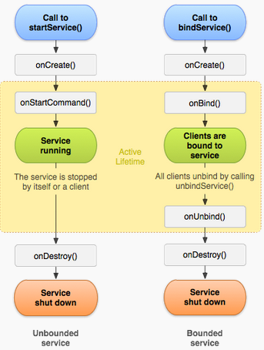
Service in Android Service Lifecycle
Active
Lifecycle
Entire Lifecycle

Slide 5
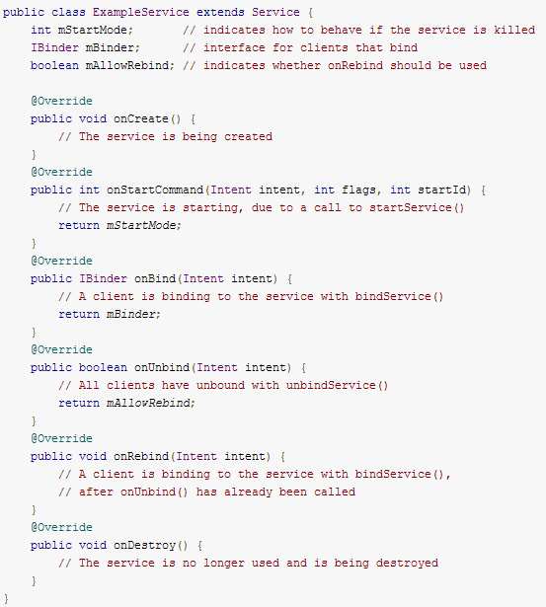
Service in Android Implementation the Lifecycle Callbakcs
All of them are needed for Remote Service
Return NULL by overriding onBind for Local Service

Slide 6
Service in Android How to Avoid Service be Terminated Unexpectedly (Low Memory)
--Foreground process: user interact with
--Visible process: onPause due to dialog popup
--Service process: background, such as playing music
--Background process: onStop, system kill it at any time
--Empty process: hold nothing of application, cache
Actively
onCreate(), onStartCommand(), onDestroy() cause current process to be in foreground state
startForeground(int, Notification) to put the started service in a foreground state
Passively
After onStart, current process is treated as Service process, but could be killed when memory is low
After onBind, current process will at least be guaranteed as the same process of all its clients, such as F or V process, and still could be killed when memory is low

Slide 7
Service in Android How to Get Service Started/Restarted
If you implement onStartCommand() to schedule work to be done asynchronously or in another thread, but service is killed
--Use START_FLAG_RETRY as flag for onStartCommand() , if the Intent is a retry because the original attempt never got to or returned from onStartCommand(), possibly the intent is lost
--Use START_FLAG_REDELIVERY as flag for onStartCommand() to have the system re-deliver an Intent for you so that it does NOT get lost if your service is killed while processing it, because START_REDELIVER_INTENT is returned from OnStartCommand() previously
--Simply, you could let your service return START_STICKY from onStartCommand() after service is started

Slide 8
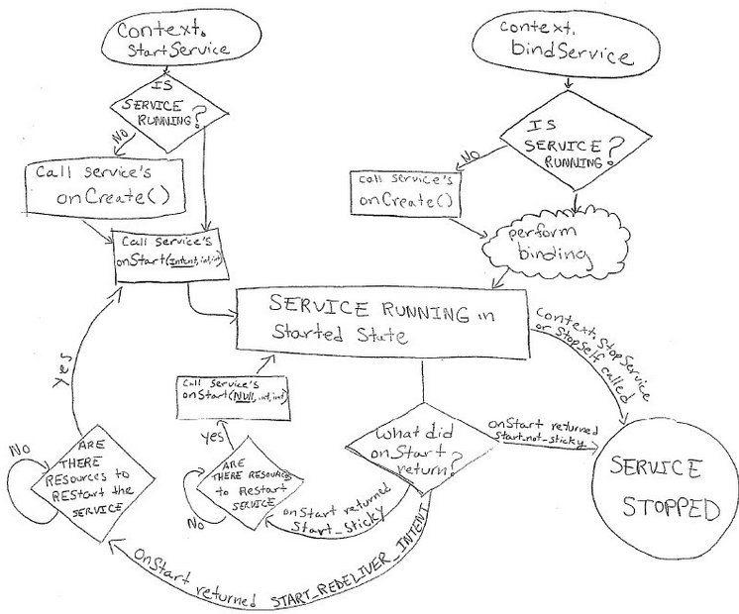
Service in Android Service Lifecycle In Another View
if this service's process is killed while it is started, then it will be scheduled for a restart and the last delivered Intent re-delivered to it again. It will only be re-started if it is not finished processing all Intents sent to it
if this service's process is killed while it is started, then leave it in the started state but don't retain this delivered intent. Later the system will try to re-create the service, because it is in the started state

Slide 9
Service in Android Service Access in Consideration of Security
Since remote processes (apps services or system services) are running in different user spaces, by default apps do NOT have access to them
-- Statically, to declare a corresponding<uses-permission> element in their own manifest
-- Programmatically, to use Context.startService (intent) to temporarily access the services that don’t protect themselves by using checkCallingPermission (permission) or checkPermission (permission, pid, uid)
Intent.FLAG_GRANT_READ_URI_PERMISSION Intent.FLAG_GRANT_WRITE_URI_PERMISSION

Slide 10
Service in Android Local Service Single Threading
IntentService
--Subclass of Service that uses a worker thread to handle all start requests in a queue, one at a time
--Be applicable to handle long time operation, such as download
--This is the best option if you do NOT require that your service handle multiple requests simultaneously.

Slide 11
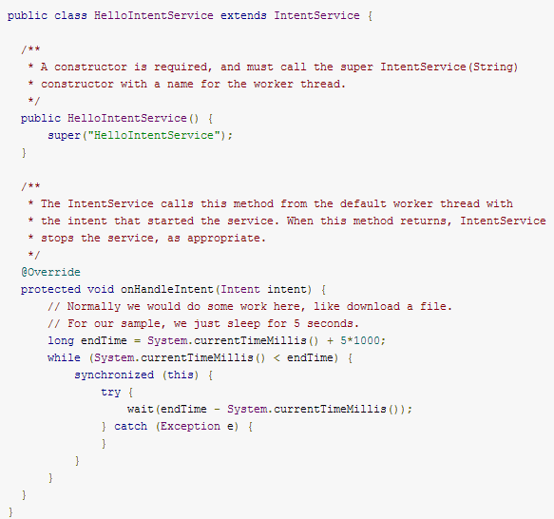
Service in Android Local Intent Service Example
Call super constructor
Stop service after method returns

Slide 12
Service in Android Local Service Multi-Threading
Service
--Parent class of IntentService that uses multi thread to handle all start requests simultaneously
--New worker thread whenever new requests come to the service, because the service uses your application's main thread by default
--This is the best option if you DO require that your service handle multiple requests simultaneously.

Slide 13
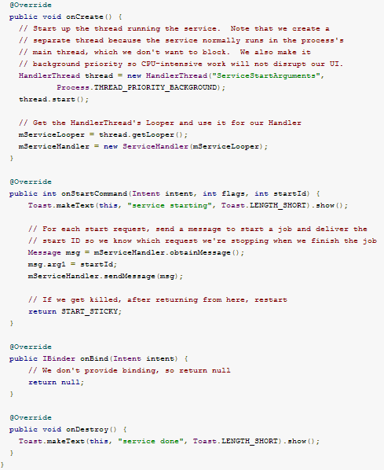
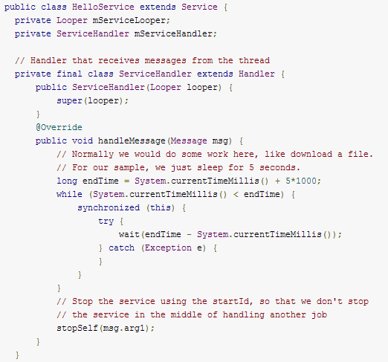

Service in Android Local Service Example
New worker thread
Send msg to the looper of handler
Alternatively, service can be stopped by stopService(id), id is used to avoid stop service that is being requested by others
Service only can be communicated with other components of same app
f the service is not already running, the system first calls onCreate(), then calls onStartCommand()

Slide 14
Service in Android Remote Service Single Threading & Multi-Threading
Bound Service
--Uses single thread or multi thread to handle all start requests in a queue or simultaneously
--Serve as Local service or Remote service (IPC)
--Typically lives ONLY while it serves another application component and does NOT run in the background indefinitely
--The system destroys the service when no clients bound to the service, after clients unbind service from server
Server:
--Define the Interface that specifies how a client can communicate with the service
--This Interface of Service must be an implementation of IBinder, and Service must return from the onBind() callback
Client:
--Interact with the service through that interface via IBinder Object that mBinder

Slide 15
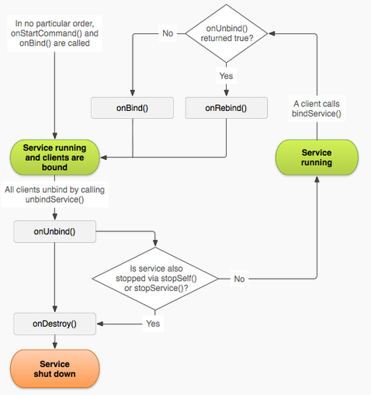
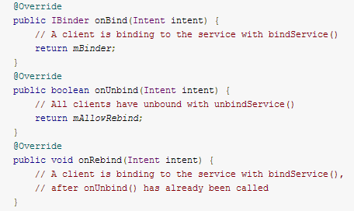
Service in Android Android Bound Service Lifecycle Management & Callback Implementation
If onStartCommand() is overridden, which will result in it is treated as Started Service, so Bound service won’t be stopped by system, unless it stop itself stopSelf() or another component calls stopService(),
Set onUnbind() return TRUE will result in onRebind() will be called in next time when client bind service

Slide 16
Service in Android Strategy of Bound Service Implementation
Extending the Binder (Local Service / Single Threading)
--service is private to own application and runs in the same process as the client
Using a Messenger (Remove Service / Single Threading)
--Interface of service to work across different processes with a Messenger that queues all requests into a single thread
Using AIDL (Remove Service / Multithreading)
--Performs all the work to decompose objects into primitives that the operating system can understand and marshall them across processes to perform IPC
Reference to a Handler (has looper), which others can use to send messages to it, which enable message-based communication across processes

Slide 17
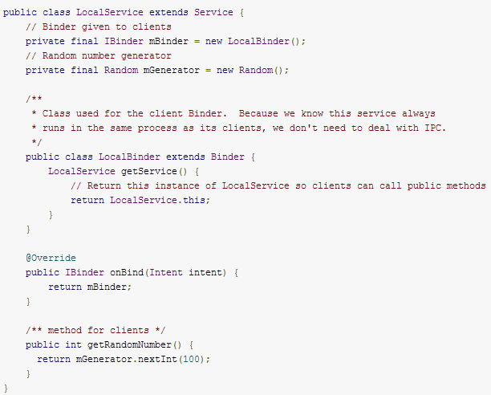
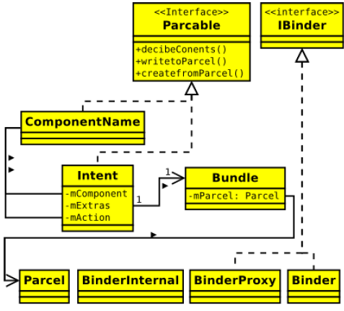
Service in Android Bound Service Implementation / Extending the Binder
Service
Return this instance of LocalService so clients can call public methods
Return interface of service that implemented IBinder
Implementation of Service

Slide 18
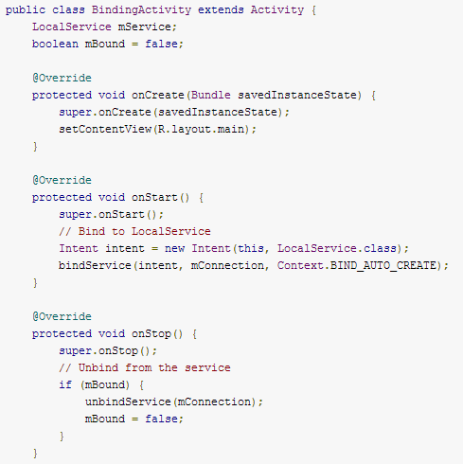
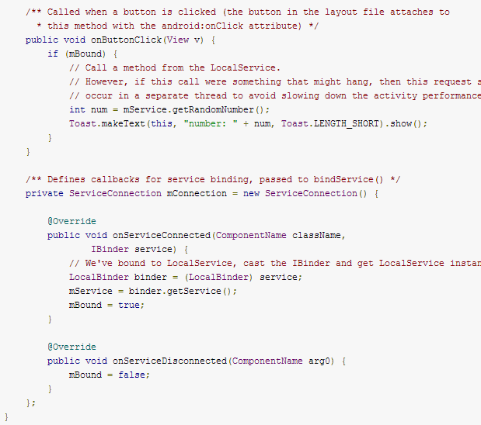
Service in Android Bound Service Implementation / Extending the Binder
Client
Use the service
Interface for monitoring the state of service
Bind the service
Get the service
Unbind the service

Slide 19
Service in Android Strategy of Bound Service Implementation
Extending the Binder (Local Service / Single Threading)
--service is private to own application and runs in the same process as the client
Using a Messenger (Remove Service / Single Threading)
--Interface of service to work across different processes with a Messenger that queues all requests into a single thread
Using AIDL (Remove Service / Multithreading)
--Performs all the work to decompose objects into primitives that the operating system can understand and marshall them across processes to perform IPC
Reference to a Handler (has looper), which others can use to send messages to it, which enable message-based communication across processes

Slide 20
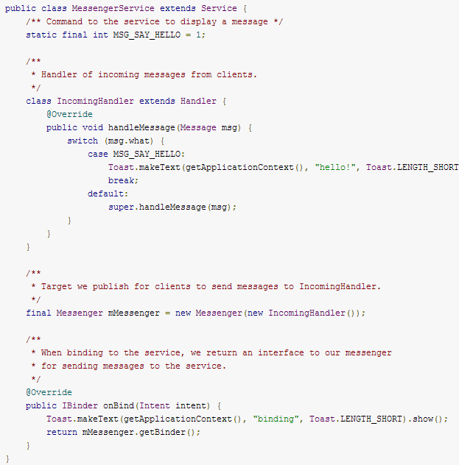

Service in Android Bound Service Implementation / Using a Messenger
Service
The Handler handle msg. that is sent from client to service via Messenger
Implementation of Service
The Handler (has looper) is used to create a Messenger object
Return the IBinder to client that this Messenger is using to communicate with its associated Handler

Slide 21
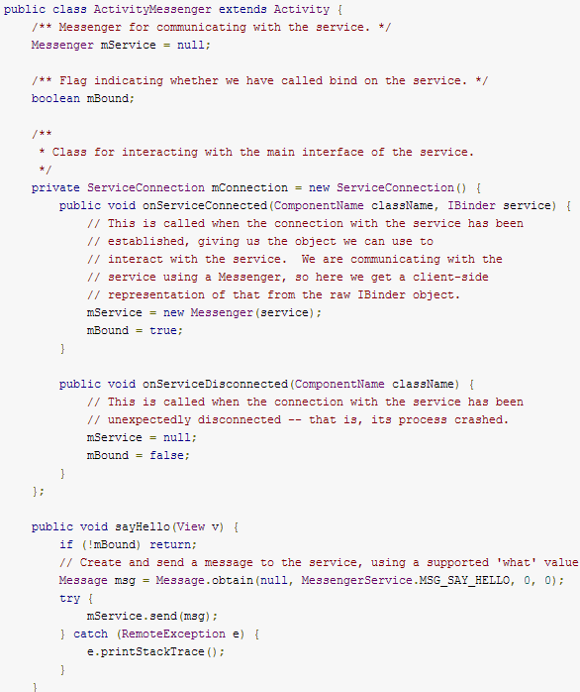
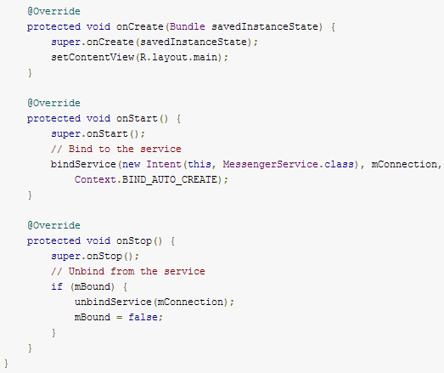

Service in Android Bound Service Implementation / Using a Messenger
Client
Interface for monitoring the state of service
Bind the service
Get the service by creating a Messenger from a raw IBinder
Unbind the service
Make service run in a remote process (instead of the standard one for its .apk)
Use the service by sending msg. to handler of service via IBinder

Slide 22
Service in Android Strategy of Bound Service Implementation
Extending the Binder (Local Service / Single Threading)
--service is private to own application and runs in the same process as the client
Using a Messenger (Remove Service / Single Threading)
--Interface of service to work across different processes with a Messenger that queues all requests into a single thread
Using AIDL (Remove Service / Multithreading)
--Performs all the work to decompose objects into primitives that the operating system can understand and marshall them across processes to perform IPC
Reference to a Handler (has looper), which others can use to send messages to it, which enable message-based communication across processes

Slide 23
Service in Android What AIDL
AIDL (Android Interface Definition Language) is similar to other IDLs
Allow you to define the programming interface that both the client and service agree upon in order to communicate with each other using IPC.
Enable one process access memory in another process by
--Marshall the objects across that boundary of process
--Decompose objects into primitives that the operating system can understand

Slide 24
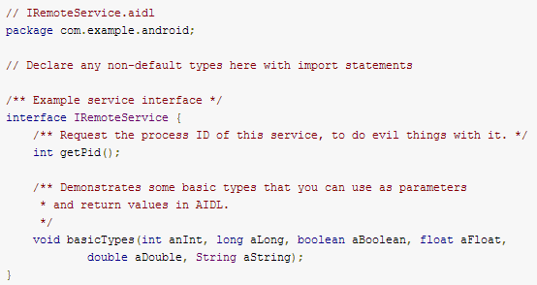
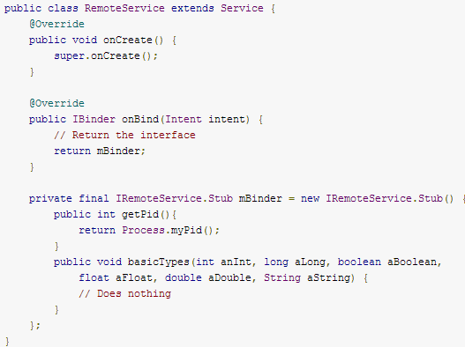
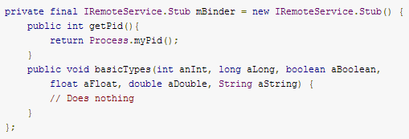
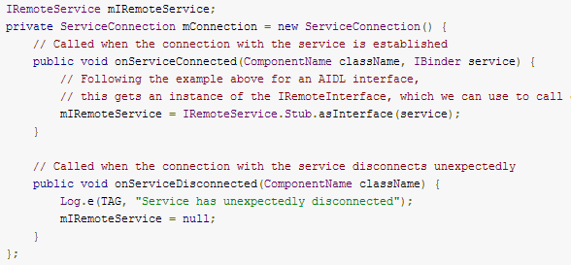
Service in Android Bound Service Implementation / Using AIDL
IRemoteservice.aidl
Remoteservice.java
Implement Service, and return IBinder Object that mBinder to client, which is used to access interface of service
Define interface and types used as parameter
IRemoteservice.java
Client.java
SDK tool generate it. Implement the interface of service, such as stub & proxy, helper method asInterface(), etc
Get Service via mBinder through helper method asInterface()
Client app must have a copy of the .aidl file in its src/ directory, if it is NOT running in the same process of service

Slide 25
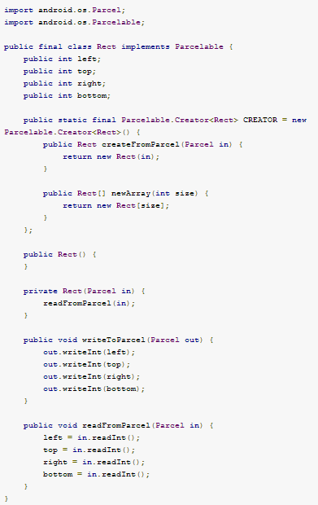
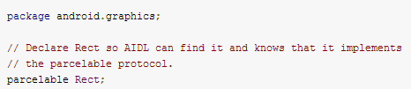
Service in Android Bound Service Implementation / Using AIDL / Passing Objects over IPC
Rect.aidl
The Objects that will be passed to client
Public CREATOR field that generates instances of your Parcelable class from a Parcel, whose data had previously been written by Parcelable.writeToParcel()
Object constructor
Method for Write and Read Object

Slide 26
Service in Android Best Practice in Bound Service
Bind during onStart() and unbind during onStop()
-- Activity interact with the service while it is visible
Bind during onCreate() and unbind during onDestroy()
--Activity to receive responses even while it is stopped in the background
--The weight of the remove process is increased by this, which cause system will more likely kill the activity
Bind during onResume() and unbind during onPause()
--Transition of activity cause overhead across process communication

Slide 27
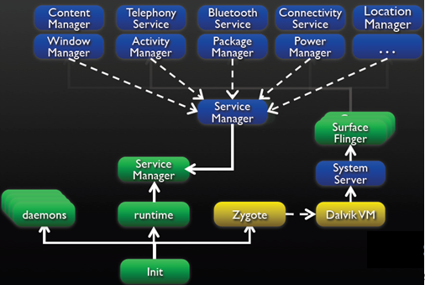
Service in Android System Services Run in System Server
System Service
The system server is started as soon as Dalvik is initialized and running in boot sequence.
The other system services will be running in the context of the System Server process.

Slide 28
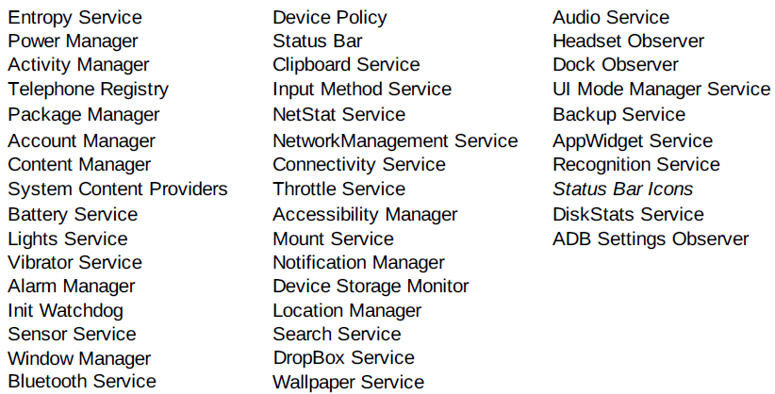
Service in Android Where are All System Services
/frameworks/base/services/java/com/android/server/
Not Up-to-date

Slide 29
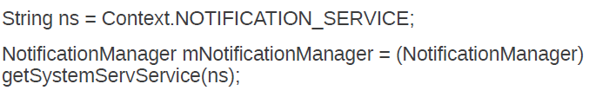
Service in Android How to Call System Services
Ex: NotificationManager Object reference:

Slide 30
Reference
http://developer.android.com
http://elinux.org/Android_Binder
http://en.wikipedia.org/wiki/
http://www.vogella.com/articles/AndroidServices/article.html
http://events.linuxfoundation.org/

